Slide 1
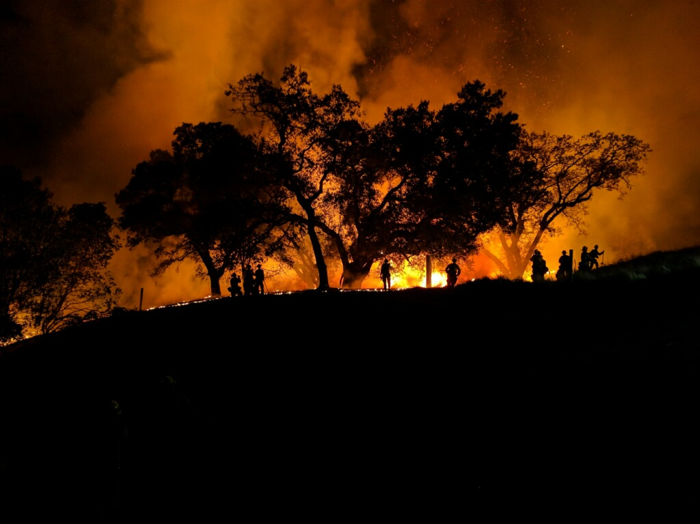
Truckee Meadows Fire Protection District
Deployment plan
(Standards of Cover)

Slide 2
Current Deployment and Performance
Deployment Plan (Standards of Cover - Chief Moore)
Strategic Plan (Chief Beaver)
Fleet Acquisition (Chief Gorgon)
Facilities (Consultant and Chief Moore)
The combination of these 4 plans will result in the District
Master Plan

Slide 3
Current Deployment and Performance
Goals
Define a consistent service level in all program areas throughout the jurisdiction by establishing minimum performance
Develop and put in place a plan that optimally deploys available resources now and for the future
Put in place a methodology that verifies and validates the plan

Slide 4
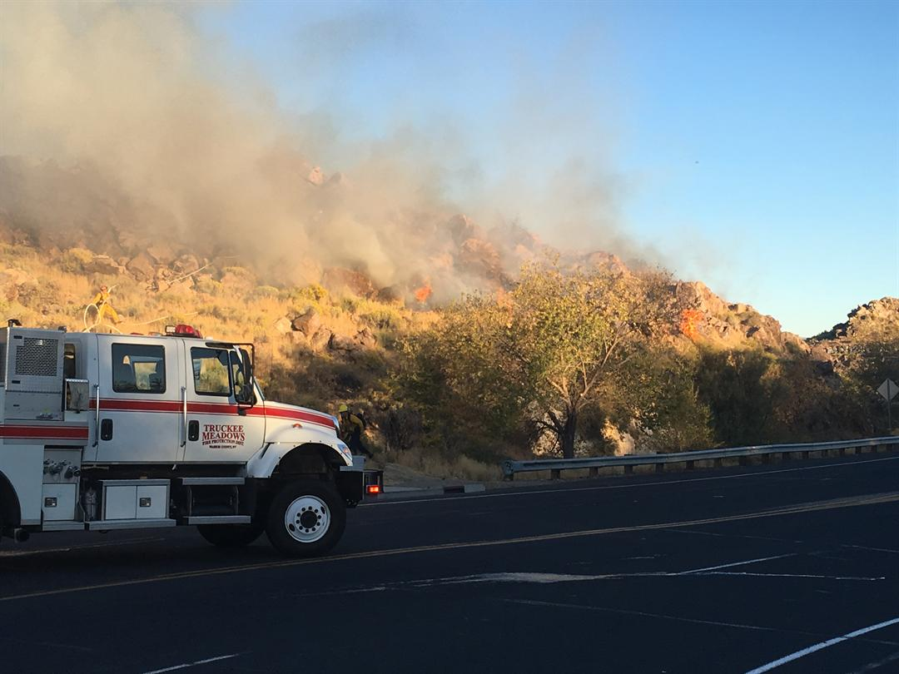
Current Deployment and Performance
Measure the historical response against a standard
Determine what gaps exist.

Slide 5
Service Area Classifications
Metropolitan: Geography with population over 200,000 and/or population density over 3,000 people per square mile.
Urban: Geography with population over 30,000 and/or population density over 2,000 people per square mile.
Suburban: Geography with population 10,000 to 29,999 and/or population density between 1000 and 2000 people per square mile.
Rural: Geography with population less than 10,000 and/or population density less than 1000 people per square mile.

Slide 6
Tiered Response
2011 Regional Standards of Cover
Suburban: The first unit capable of initiating effective incident mitigation should arrive within 10 minutes, 85 percent of the time from the receipt of the call.
Rural: The first unit capable of initiating effective incident mitigation should arrive within 20 minutes, 85 percent of the time from the receipt of the call.

