Slide 1
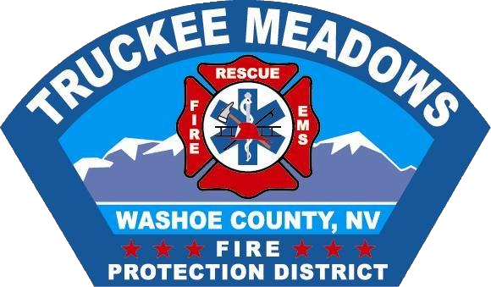
Truckee Meadows Fire Protection District
Jasper Fire
July 13, 2019

Slide 2
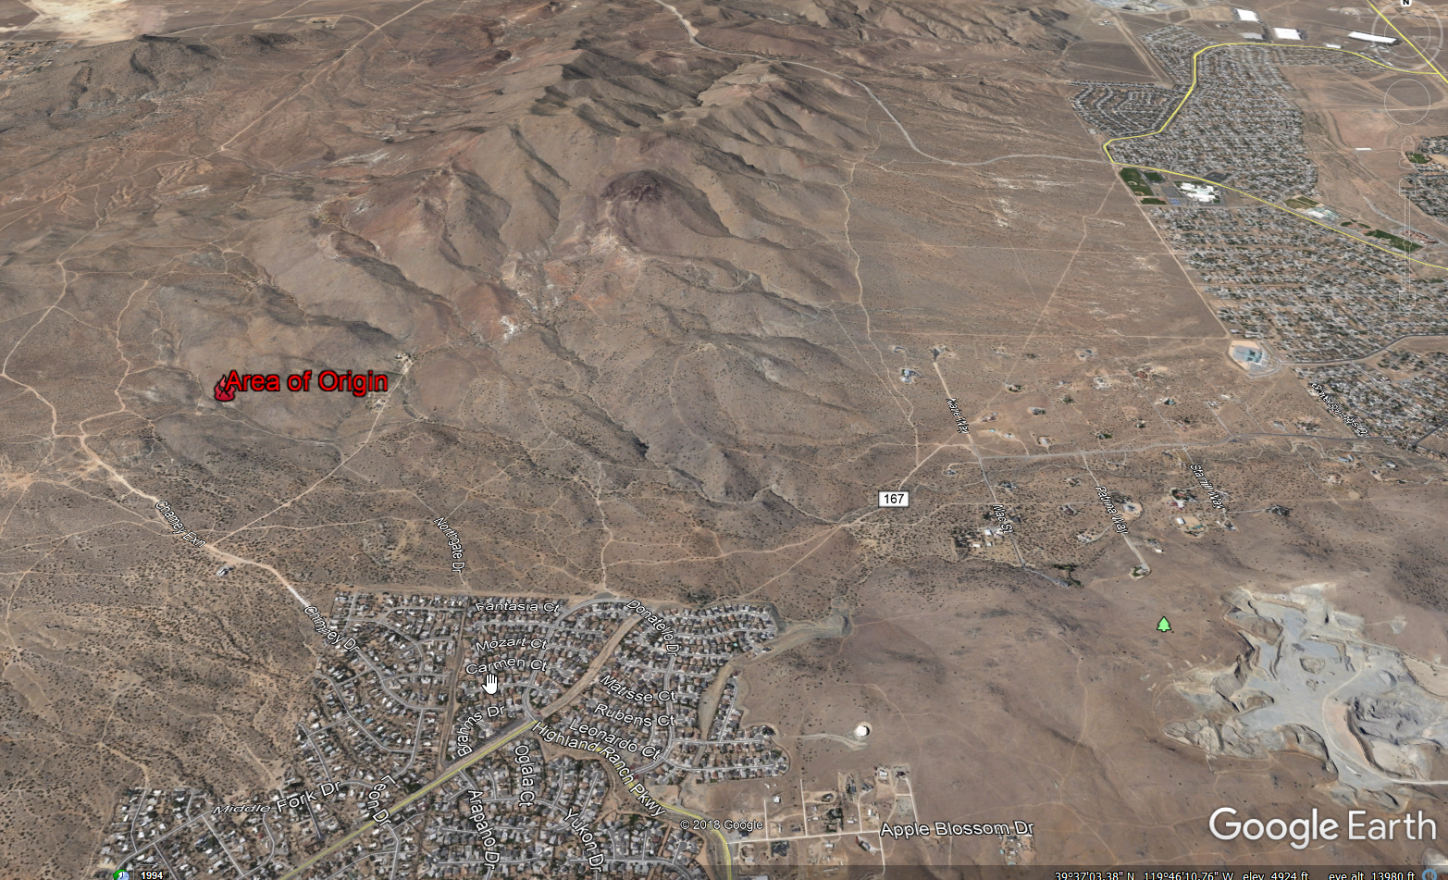
Location
(North of Sun Valley/West of Spanish Springs)

Slide 3
Current Fire Statistics
(As of 7/15/19)
1165 Acres burned
80% Contained
Current Personnel: 130 (high of approximately 300)
Structures Damaged or Destroyed: 3 (2 residences & 1 out building)
Full Containment estimated at 1800hrs on July 16th
2 persons arrested for gross negligence related to starting the fire while target shooting
FMAG Declaration Received- Costs at $740,000 as of 7/15/19

Slide 4
Perimeter Map

Slide 5
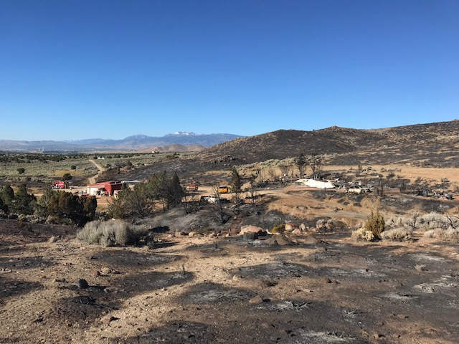
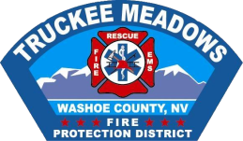
Structures Saved & Lost

Slide 6
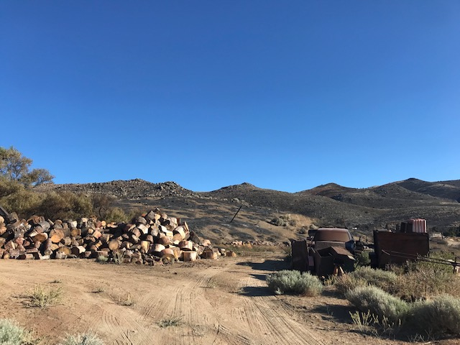
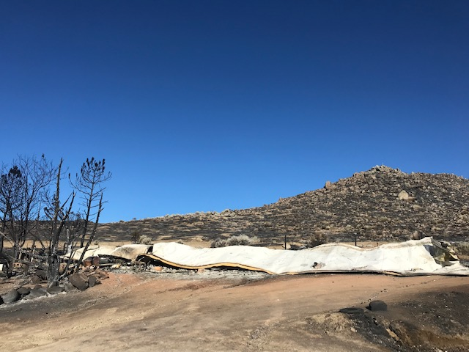
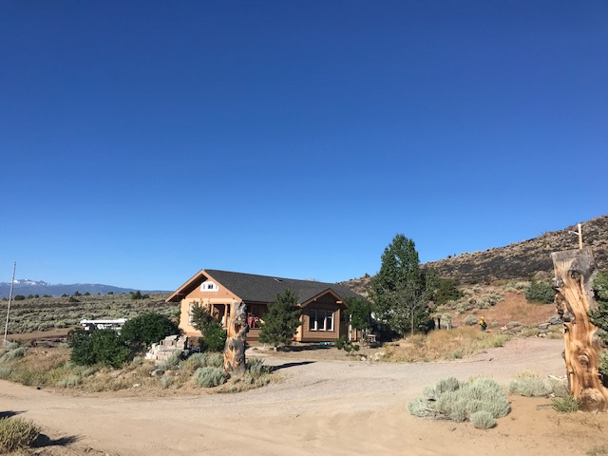
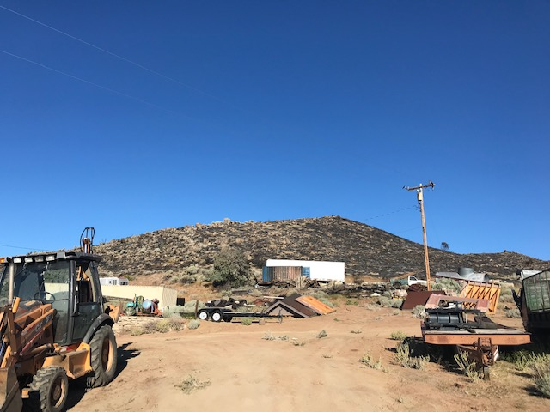
Structures Saved & Lost

Slide 7
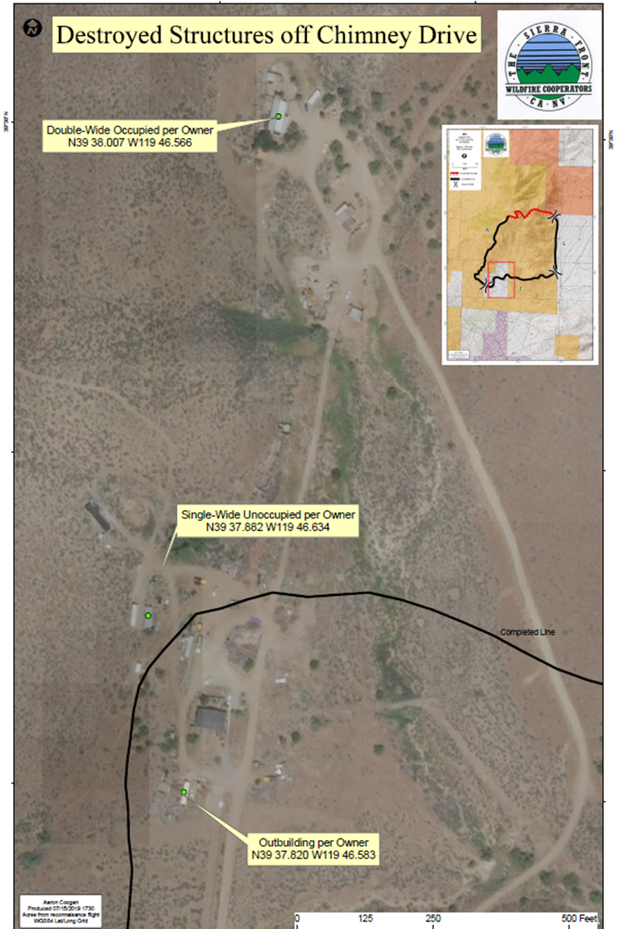

Slide 8
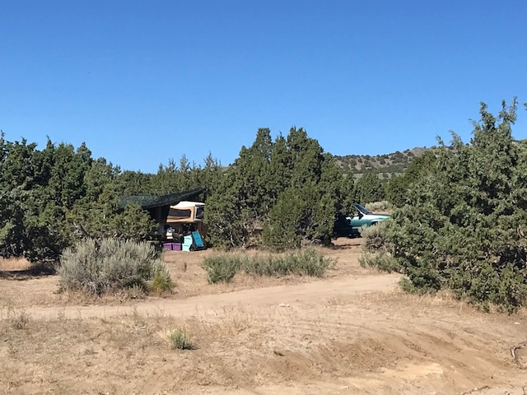
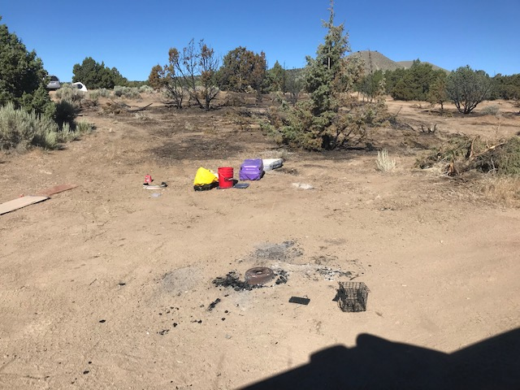
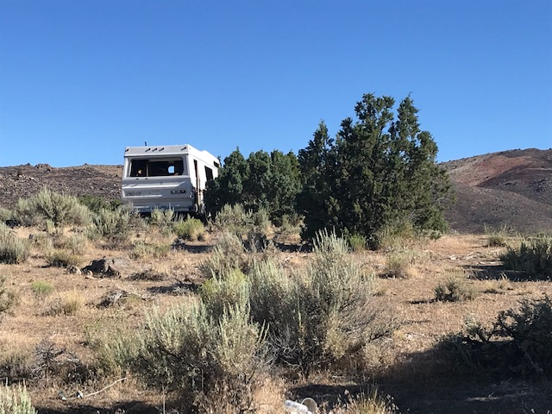
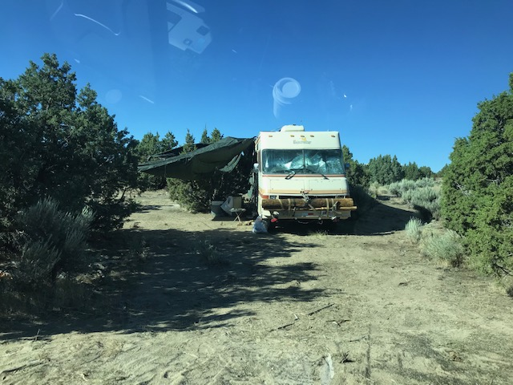
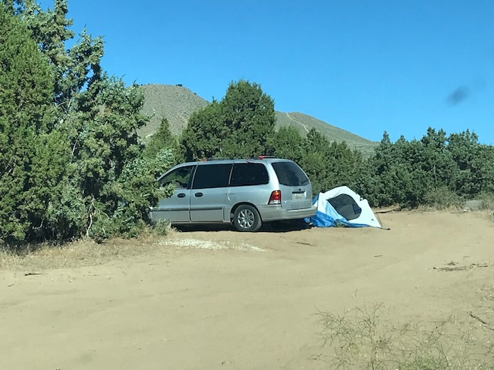
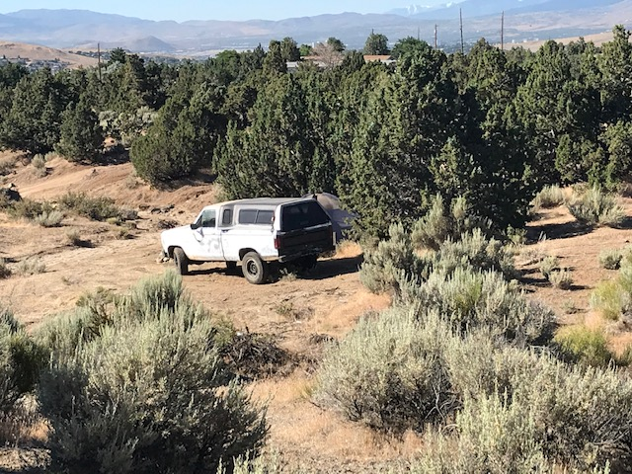
Chimney Rd. Hazards

Slide 9
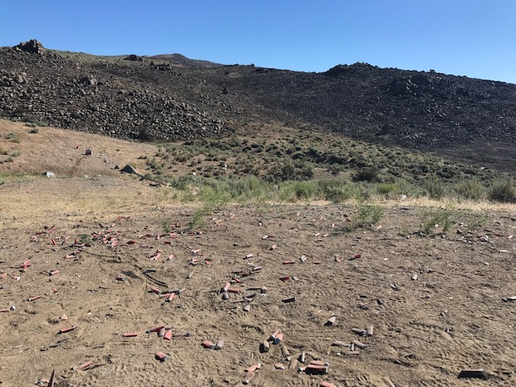
Shooting Areas

Slide 10
BLM Fire Restrictions
Fire restrictions prohibit the following:
Building, maintaining, attending or using a fire (using wood, charcoal or any other material), campfire or stove fire except a portable stove using gas, jellied petroleum or pressurized liquid fuel outside of a developed fee campground or picnic area (except by permit).
Smoking, except within an enclosed vehicle or at a developed campground or picnic area.
Operating vehicles or other motorized equipment off of existing paved, gravel or dirt roads.
Welding or operating an acetylene torch with open flames, except by permit.
Using or causing to be used, any explosive, except by permit.
Possession or use of fireworks or any other incendiary device.
Use of tracer rounds (always prohibited), steel-core ammunition, or exploding targets, including Binary Explosive Targets while recreational shooting.

Slide 11
Questions???

