Slide 1
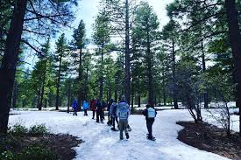
Galena Burn Plan 2020
August Isernhagen
Division Chief - Wildfire and Fuels

Slide 2
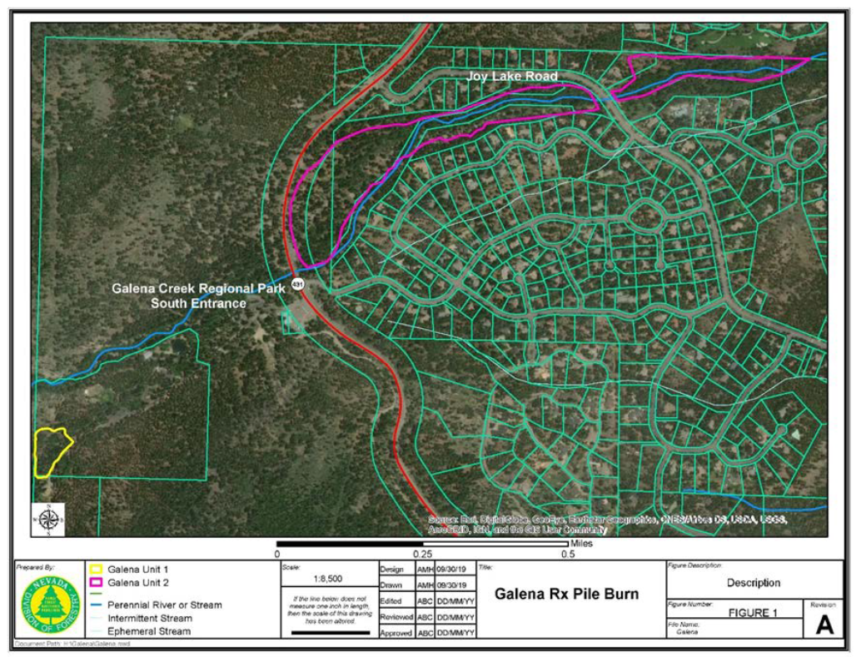
Galena Burn Description
Area Description
Unit One is in Galena Creek Park – 2 Acres.
Unit Two is along Joy Lake Road – 34 Acres.
Fuels on site are mixed conifer forest (Jeffrey pine, white fir, aspen, and cottonwood) with an understory of forbs, grasses, and brush.
Approximately 80 piles have already been cut and built. These are pile burns only allowable after high precipitation events.

Slide 3
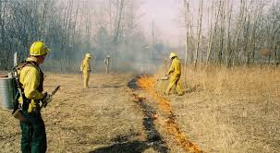
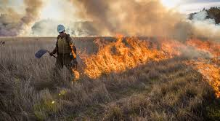
Broadcast vs. Pile Burning
Broadcast/Area burning
Involves burning areas of ground fuel in a continuous fire.
Most cost effective.
Has more specific prescription requirements (fuel, weather, and topography have to align to allow fire to burn). These include drier fuel and weather conditions.
Due to wetter fuel and dispersed heat, less complete combustion creates more smoke particulates and air quality concerns.

Slide 4
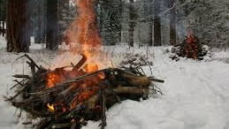
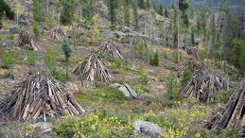
Broadcast vs. Pile Burning
Pile burning
Involves burning pre-cut and processed fuels that have been piled into distinct and contained areas.
Less cost effective than broadcast burning, but more efficient than other processes (i.e. removal through logging or chipping).
Can be done in a wider range of environmental conditions i.e. snow. Provides for a safer and more controlled burn compared to broadcast.
Due to higher heat concentration and drier fuels, smoke management concerns are generally less than in broadcast burning.
Complete mop up is more effective due to isolated heat area and complete combustion.

Slide 5
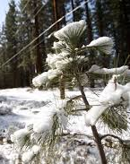
Galena Burn Plan – Prescription Requirements
Prescription/Time of Implementation
Mid-flame wind speed - <12 mph.
20-foot wind speed - <35 mph.
Minimum mixing height – 1,200 feet above ground level (smoke dispersion).
Relative humidity – 15-100%.
Temperature - <70 degrees F.
1-hour fuel moisture (0-.25” diameter) - >15%.
10-hour fuel moisture (.25-1.0” diameter) - >10%.
Snow depth - < 2”.
Snow coverage - >60%.
Wetting rain >.5” in previous 48 hours. Reno average app. 7 inches per year.
Obtained through computer modeling.

Slide 6
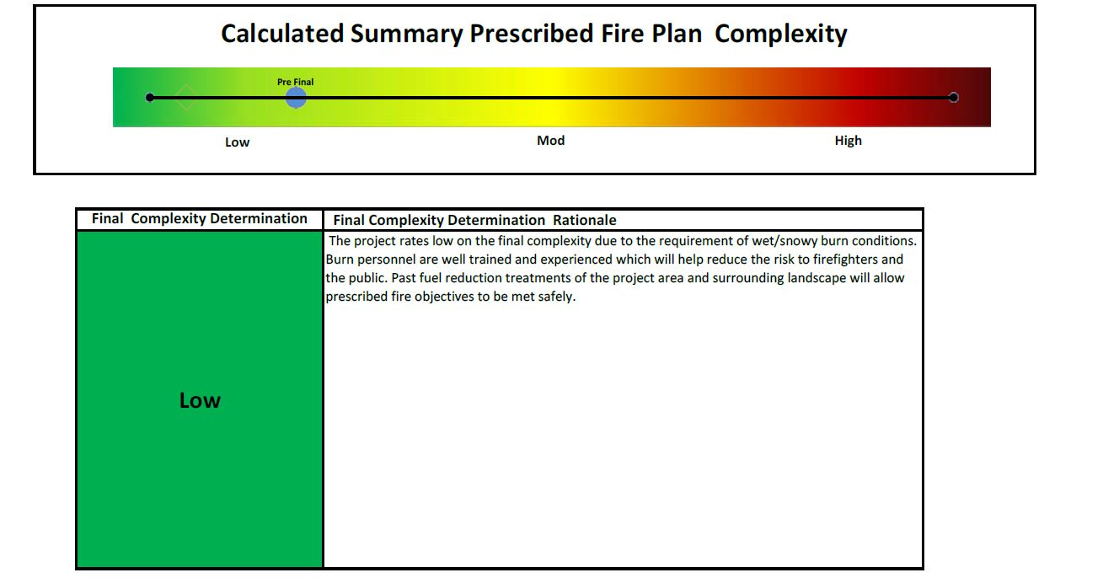
Galena Burn Plan Elements Cont’d.
Complexity Analysis
Reviews risk management elements present, their quantity, and their significance. Risk for this plan is evaluated as low.
Reviewed by outside personnel.
Reviewing personnel include: Prescribed Fire Burn Boss II (external), State Fire Management Officer, State Forester, and TMFR Wildfire/Fuels Division Chief.

Slide 7
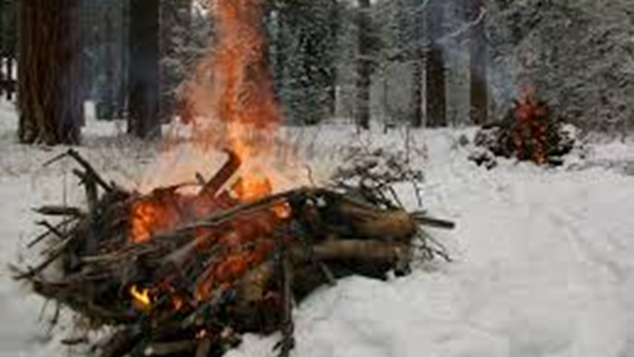
Galena Burn Plan Elements Cont’d.
Duration
Approximately 16 days to complete.
Minimum Personnel and Equipment
Burn Boss III (RXB3).
Type II wildland squad (9-12 personnel).
TMFR will contribute an additional Burn Boss and Type V Engine for additional man-power and assistance with oversight.

Slide 8
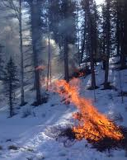
TMFR Recommendations
TMFR recommends supporting the Galena Prescribed Fire Project with our contributions and assistance with oversight.
This will reduce fuel loading and increase TMFR firefighting effectiveness when (not if) the next wildland fire occurs.
TMFR recommends a combination of treatments; chipping and processing material when possible and burning when not. Fuels management cannot be achieved without incorporating both elements.
Costs of eventual wildfire mitigation without treatment will far surpass the costs of burning and the risks associated.

