Slide 1
Broken Hill Structure Fire
September 4, 2021

Slide 2
Broken Hill Structure Fire Timelines
12:17:32: Reno ECOM enters a call for a smoke report in the area of South Meadows & South Virginia. Dispatches E12 at 12:19:33
12:17:50: Reno ECOM enters a call for an outside fire “South of U-Haul” on S. Virginia St. Reno Engine 3 is dispatched at 12:20:21
12:19:42: Reno ECOM enters a call for a structure fire at “Pinion Hills Veterinary” for a fire at a house to the rear of that location. Reno ECOM dispatches full structure fire at 12:21:03
12:23:38: TM Captain observes smoke from the rear of the station and advises TM Dispatch to create an incident.
12:26:49: TM Engine 33 arrives on scene and reports a working structure fire at 11085 Broken Hill Road

Slide 3
Initial Smoke Report
Outside Fire Report
Structure Fire
Animal Hospital

Slide 4
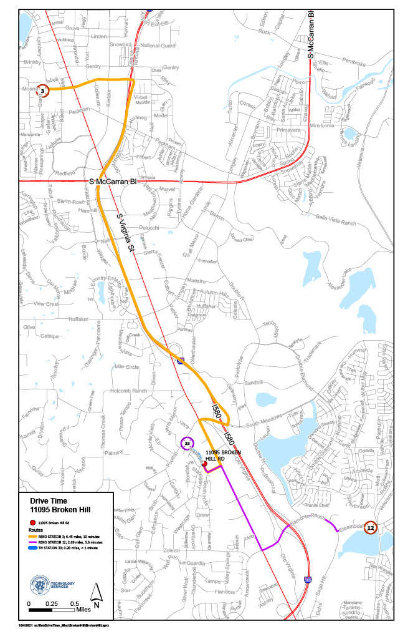

Slide 5
