Slide 1
NNPH and Hazardous Materials Response
Robert Fyda, PE, REHS
EHS Division Director

Slide 2
Definitions
NNPH HazMat Program – calls dealing with hazardous waste and other uncontrolled sites
  Drug labs – assessment / exposure
  Haz Waste – residential
NNPH On Call Program – EH response for after hours issues at permitted facilities or other work that falls under EH purview.
  Restaurant Fires
  Hotel Outages
  Safe Drinking Water – Boil Water Orders

Slide 3
NNPH HazMat History
Program started in 1980’s
  Stand alone on-call team, Environmental Health On-Call was a separate team
  Original regional hazmat team - team of 3 originally
  Lead response group after initial incidents associated with Sierra Chemical explosion and 1997 flood cleanup response
  Specialized in clandestine drug labs, working with law enforcement and the DEA
  Fully capable team to conduct level A entries.
Team grew to four in the late 1990’s / early 2000’s.
By mid 2000’s team was comprised of eight, including two hazardous materials specialists

Slide 4
NNPH HazMat History (con’t)
2008 Recession
  Team was downsized to 1 HM specialist and 5 responders
  Shift to voluntary status for a period of time
  Creation of one combined EH response team (on-call and HazMat)
  No longer conducted entries / suited up – technical advisory role.
Current status
  No Hazmat Specialists - 3 EH responders w/ differing degrees of HazMat training
  Conduct joint trainings with Regional Hazmat team

Slide 5
NNPH Legal Authority
District Boards of Health created pursuant to NRS 439.370 (i.e., DBOH) have responsibilities related to:
  Solid Waste Management Authority under NRS 444.627-495 specifically excludes hazardous waste solid waste management;
  Includes specific types of hazardous waste - waste tires (NRS 444.505) & asbestos (NAC 444.969)
  However, there appears to be no statutory mandate to regulate general hazardous waste.
The primary responsibility for hazardous waste regulation lies with the State (Division of Environmental Protection and the Department of Conservation and Natural Resources) and other entities designated under NRS / NAC Chapter 459.
  No delegation of hazardous waste authority to NNPH has occurred

Slide 6
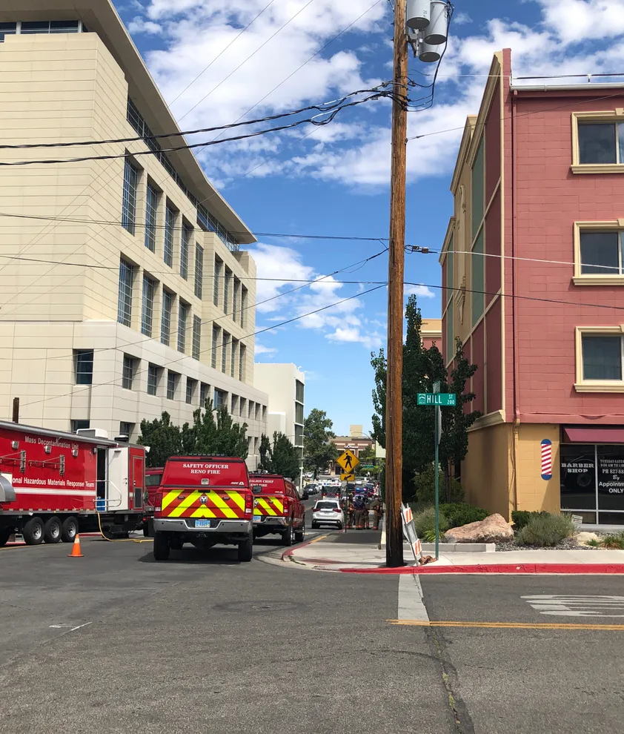
NNPH Going Forward
NNPH is standing down the NNPH HazMat response team due to:
  Lack of continuity – lack of technical knowledge
  No dedicated funding for a HazMat program
  The gap in Hazardous Materials has been adequately filled by the local jurisdictions (TRIAD)
Situations where we have no regulatory authority
  Residential (e.g - apartment complexes / single family dwellings / etc)
  Non-NNPH regulated facilities
Transition plan with partners

